Slide 1
Data Mining-Project Peer-to-Peer Lending
Bibin Jose
Jaideep Sai
Arshad Jamal
Kireet Bharadwaj

Slide 2
Contents:
Introduction
Dataset Overview
Problem Statement
Data Cleaning & Pre-Processing
Data Visualization using Tableau
Data Modeling and Inference
Future Enhancements

Slide 3
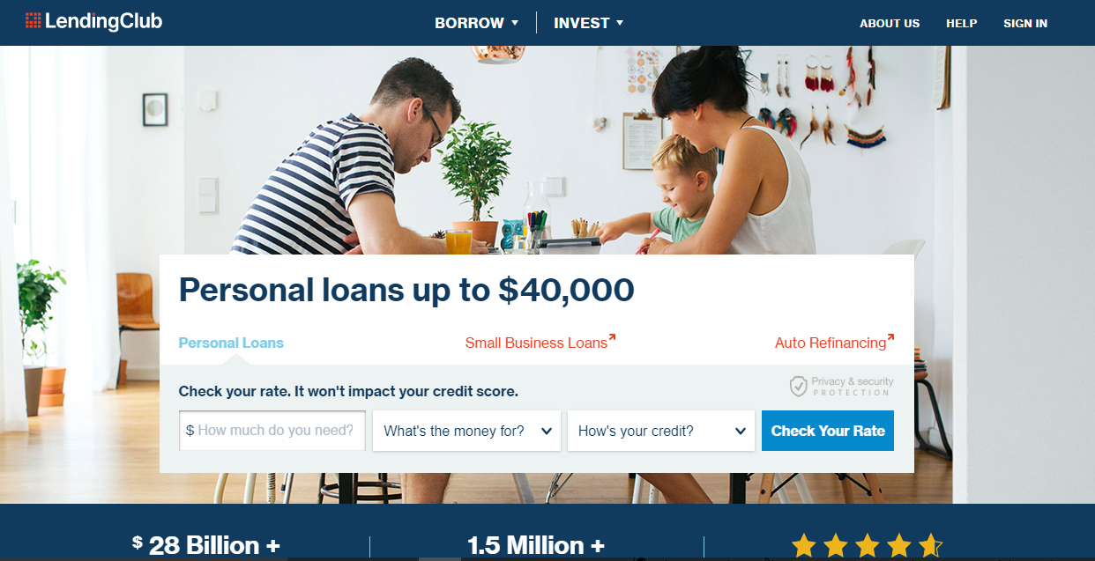
Lending Club Data Source : https://www.lendingclub.com/info/download-data.action

Slide 4
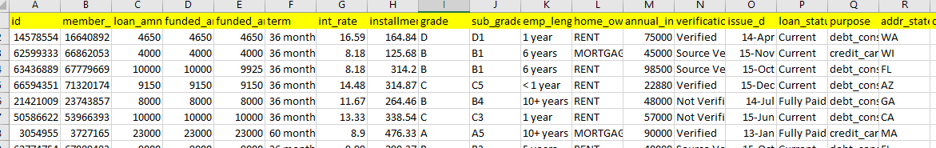
Dataset Overview
Dataset was acquired from the official website of Lending Club. Contains loan data for the period 2007-2015.
Dataset contains around 8 lakh instances and 75 attributes.
6 Non-predictive variables
2 target variables : loan_status, int_rate_cat

Slide 5
Problem Statement
Design and develop a model for the predicting whether a prospective borrower would “charge-off”.
Predicting whether a borrower will fall in the low, medium , high interest rate range.
Predicting whether a borrower would receive the complete applied loan amount from the investor.
Derive insights from the lending club loan data to reduce the risk of bad loans

Slide 6
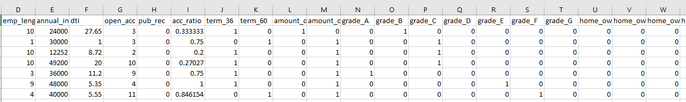
Data Cleaning & Pre-Processing
Analyzed various factors affecting the “charge-off” of a borrower.
Dataset consisted of 75 variables which we trimmed down to 41 variables by creating other indicator variables and removing redundant variables using Python & Excel.
Transformed categorical variables to binary using the concept of One Hot Encoding Technique.

Slide 7
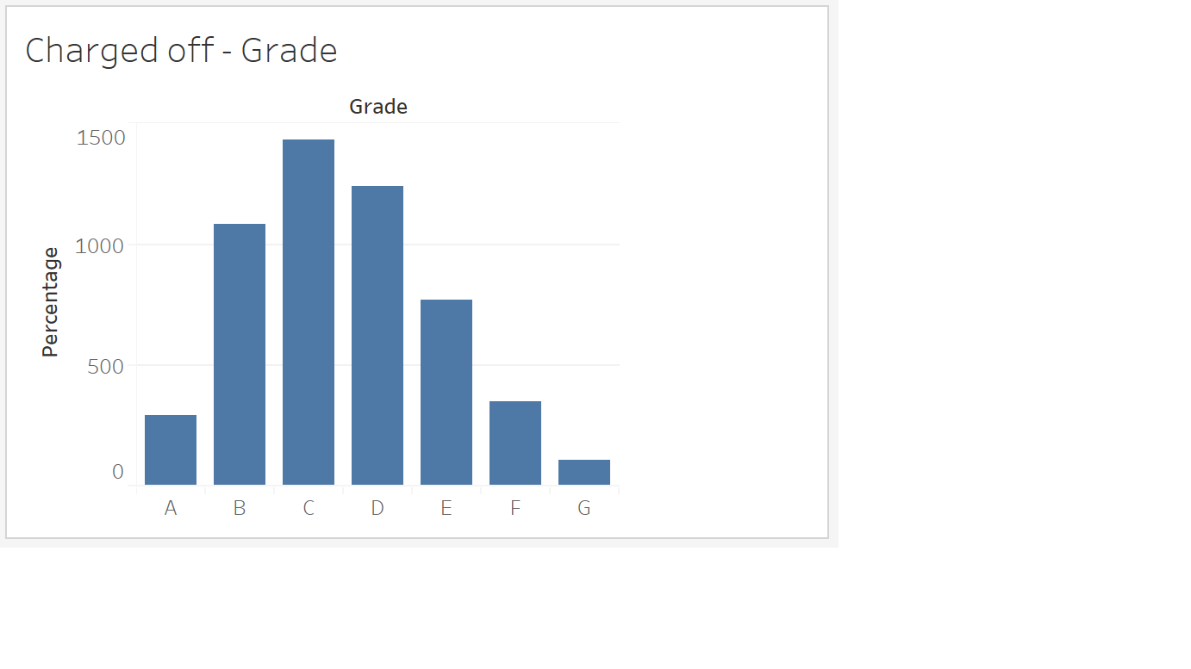
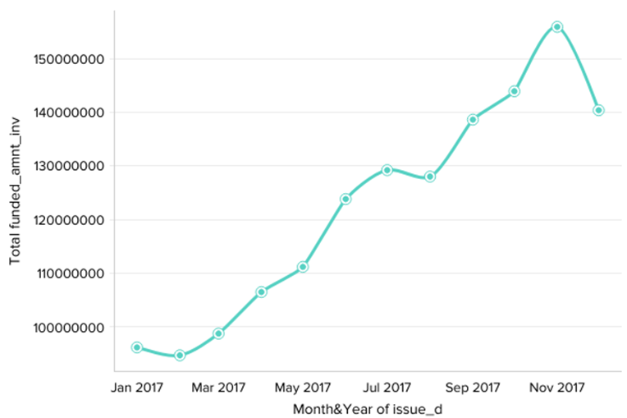
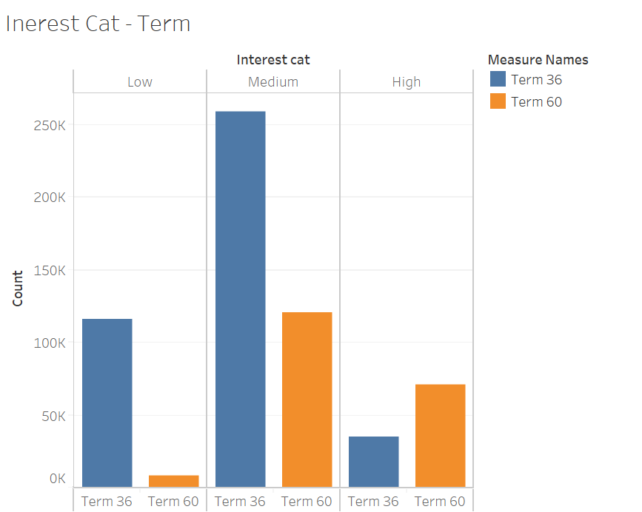
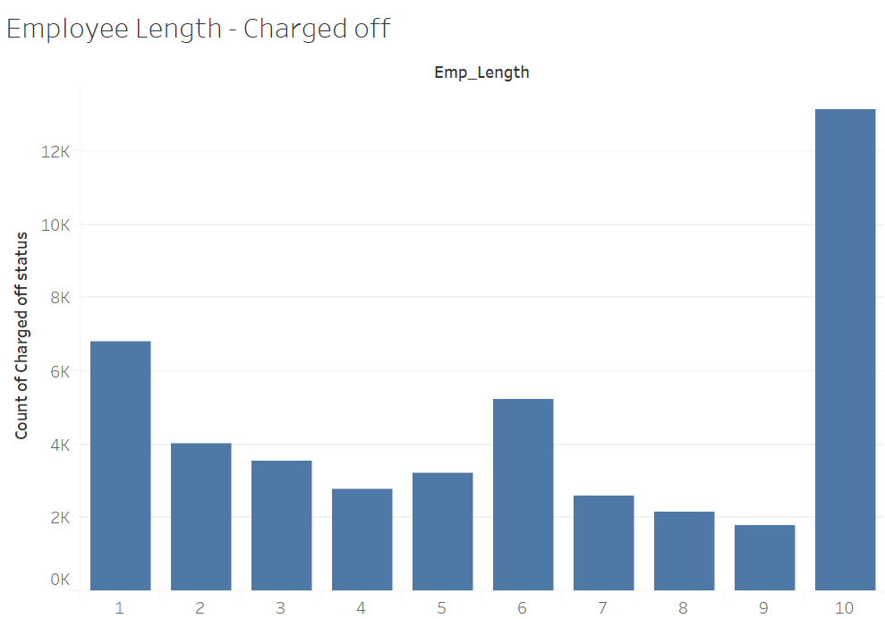
Data Visualization using Tableau

Slide 8
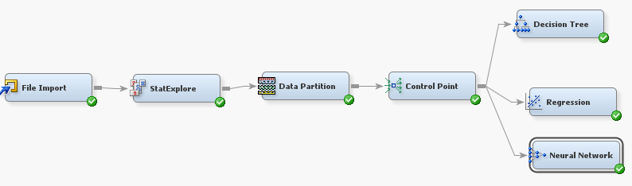
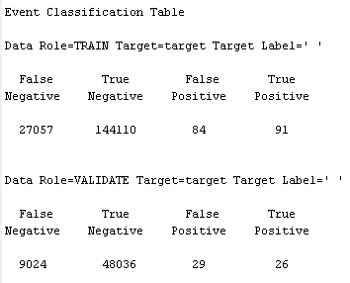
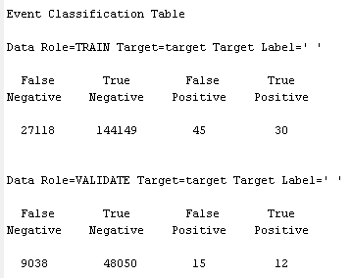
Data Modeling-1
Predicting whether a borrower would “charge-off”.

Slide 9
Inference
‘Logistic Regression’ and ‘Neural Net’ models were used for predictive modeling.
The misclassification rate is approximately 16% for logistic regression and Neural Network.
The overall accuracy of the model is high, but since we are interested in predicting the charged-off customers ,the ‘True Positive Rate’ is very low.
Our inference from the result is that the charged-off customer cannot be predicted.

Slide 10
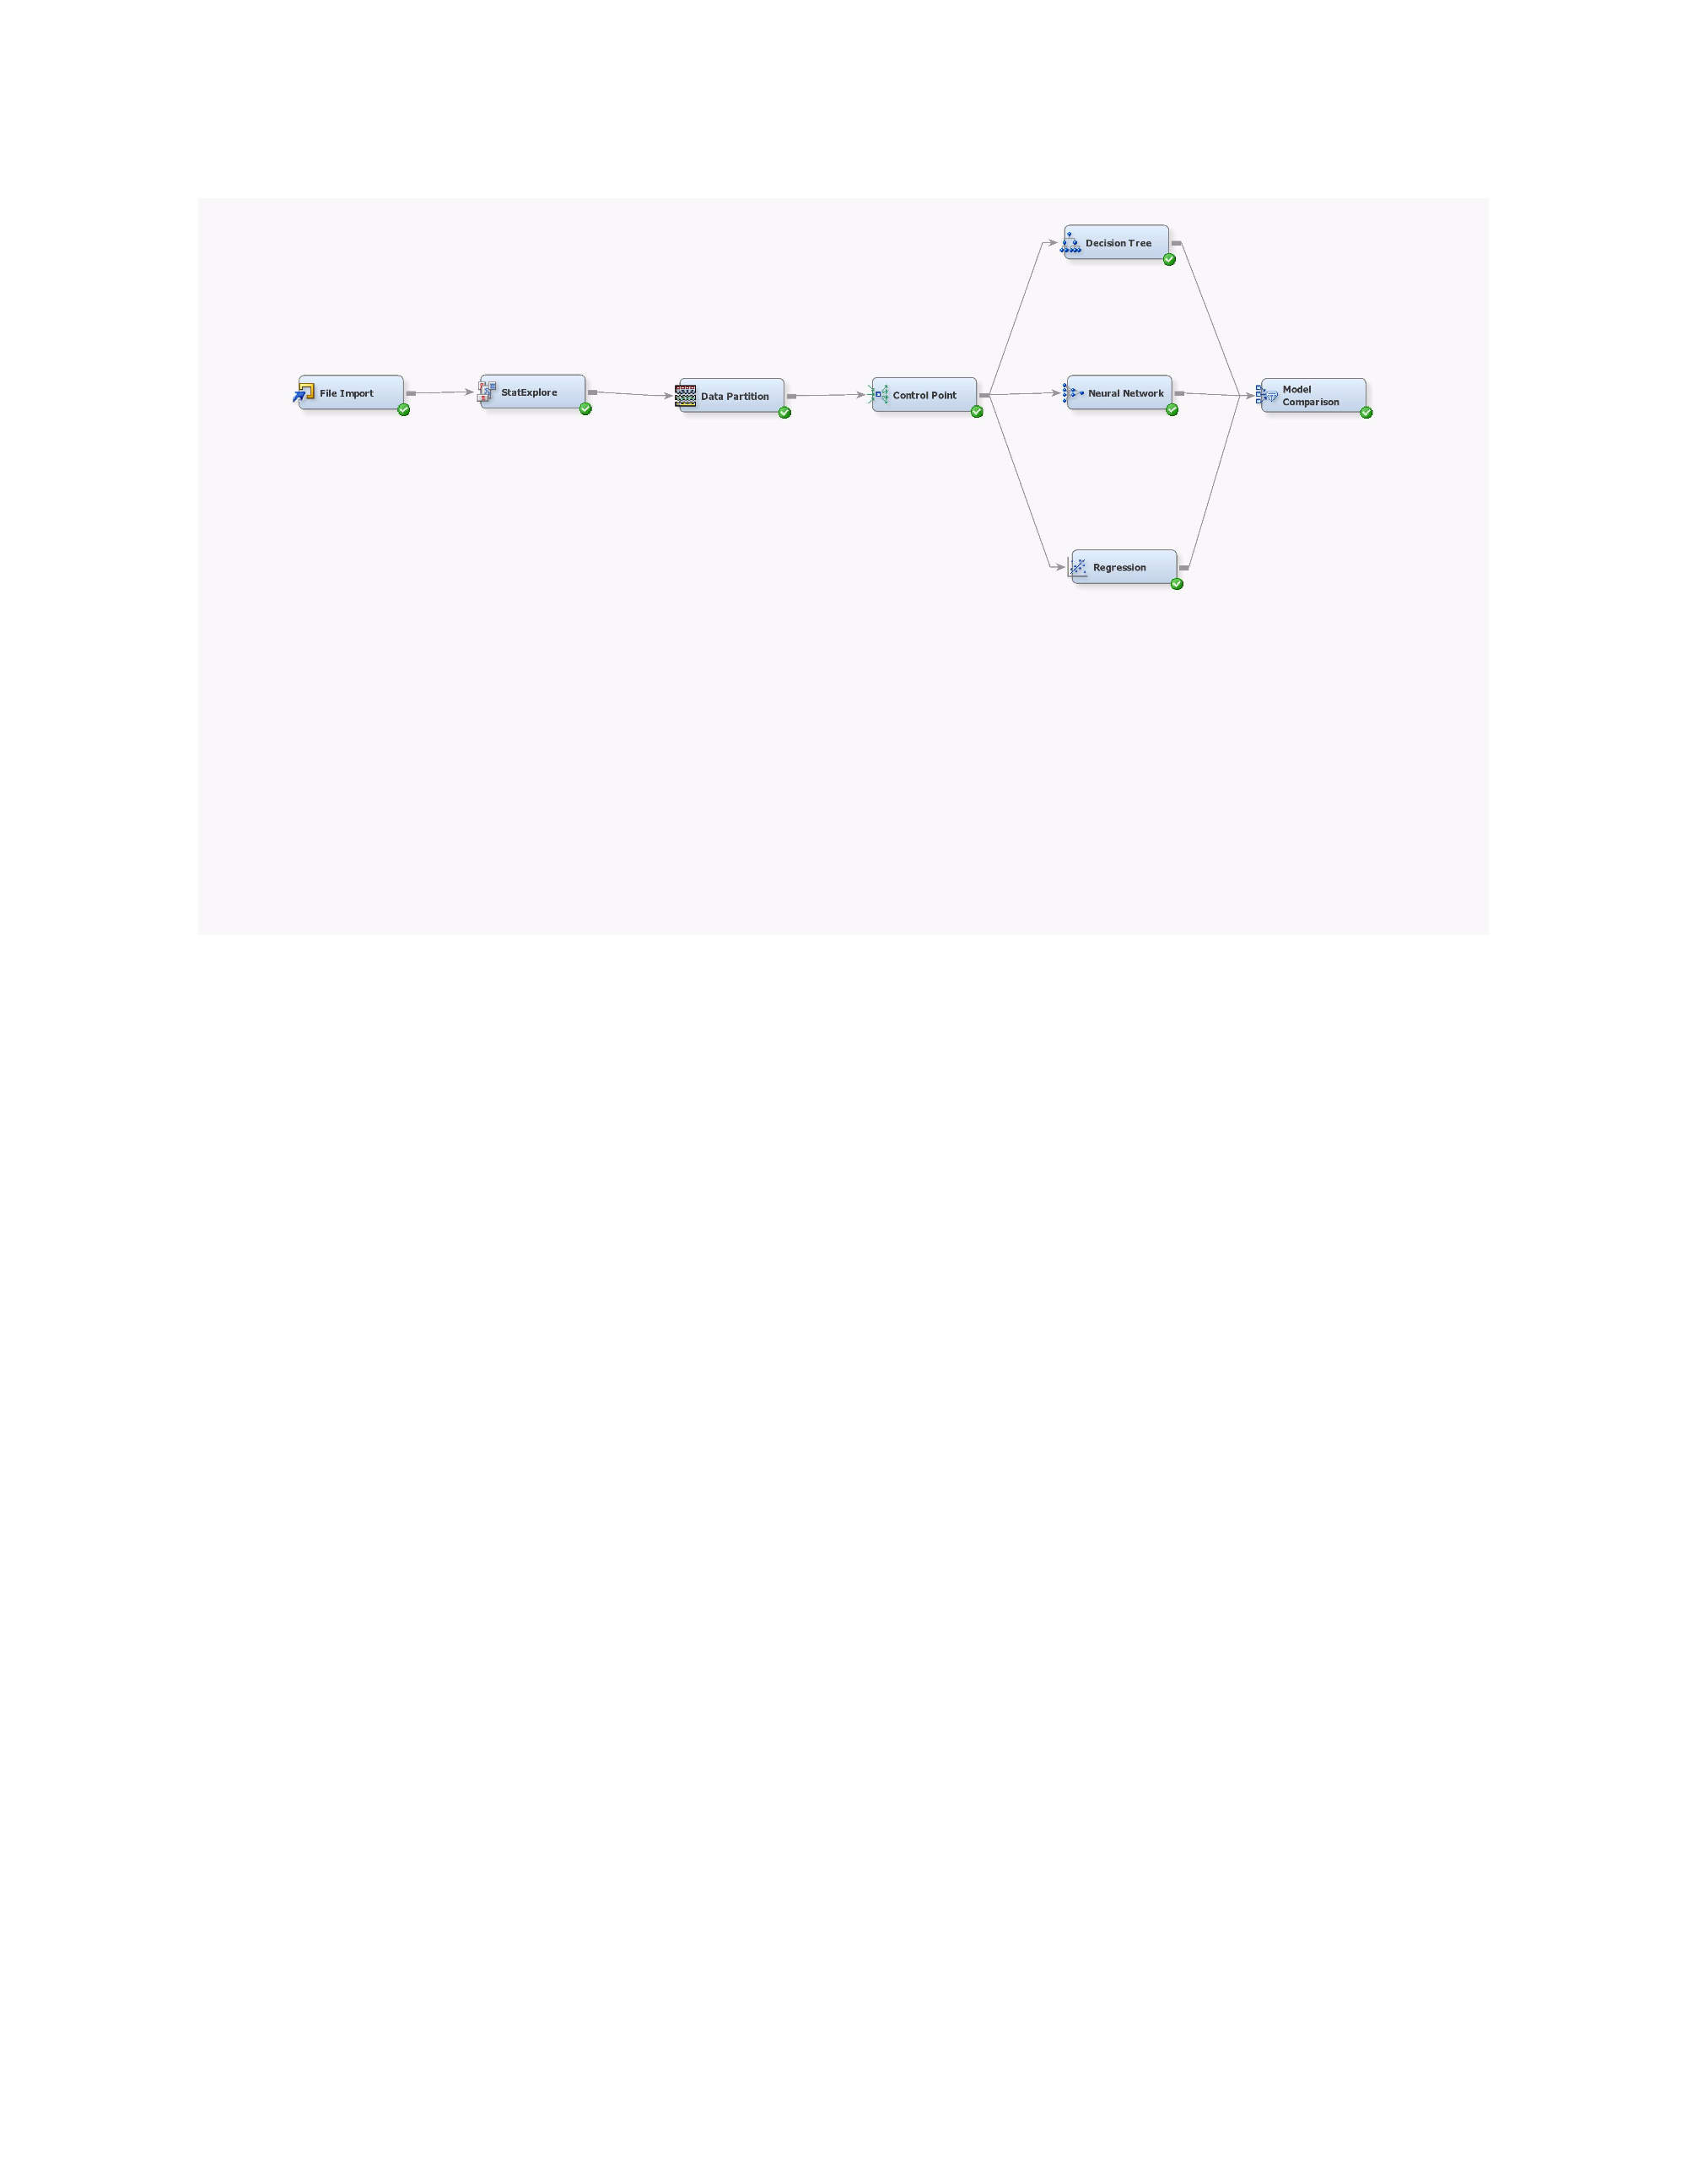
Data Modelling-2
Predicting whether a borrower will fall in the low, medium , high interest rate range.
We created the ordinal target variable ‘interest rate range’ into 3 levels of low, medium, high by analyzing the interest rate trend.

Slide 11
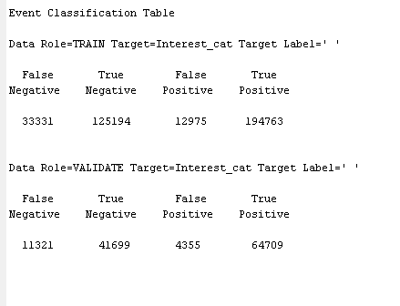
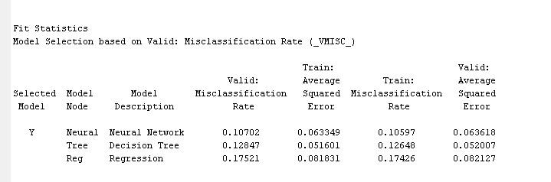
Inference
Models used were Logistics Regression, Decision Tree & Neural Net.
The misclassification rate for Decision Tree is 12%. The overall accuracy of the model is too high.
Our inference is that the model works very well for predicting the interest rate group of the prospective borrower.

Slide 12
Future Enhancement
Statistical techniques such as Principal component analysis , support vector machines could be used on the data, before running the model to improve the accuracy.
Title(Loan title provided by the borrower) column could be used for NLP techniques and also sentiment analysis.

Slide 13

Thoughts & Suggestions…!!!

